Slide 1
Data Mining Presentation
Prepared By Sumon Karmakar

Slide 2
Data Mining Presentation
Definition of Data Mining:- Data Mining is defined as extracting information from huge sets of data. In other words, we can say that data mining is the procedure of mining knowledge from data. The information or knowledge extracted so can be used for any of the following applications −
Market Analysis
Fraud Detection
Customer Retention
Production Control
Science Exploration

Slide 3
Data Mining Presentation
Data Mining Application:- Data mining is highly useful in the following domains −
Market Analysis and Management
Corporate Analysis & Risk Management
Fraud Detection
Apart from these, data mining can also be used in the areas of production control, customer retention, science exploration, sports, astrology, and Internet Web Surf-Aid

Slide 4
Data Mining Presentation
Market Analysis and Management:-Listed below are the various fields of market where data mining is used −
Customer Profiling − Data mining helps determine what kind of people buy what kind of products.
Identifying Customer Requirements − Data mining helps in identifying the best products for different customers. It uses prediction to find the factors that may attract new customers.
Cross Market Analysis − Data mining performs Association/correlations between product sales.
Target Marketing − Data mining helps to find clusters of model customers who share the same characteristics such as interests, spending habits, income, etc.
Determining Customer purchasing pattern − Data mining helps in determining customer purchasing pattern.
Providing Summary Information − Data mining provides us various multidimensional summary reports.

Slide 5
Data Mining Presentation
Corporate Analysis and Risk Management:-Data mining is used in the following fields of the Corporate Sector −
Finance Planning and Asset Evaluation − It involves cash flow analysis and prediction, contingent claim analysis to evaluate assets.
Resource Planning − It involves summarizing and comparing the resources and spending.
Competition − It involves monitoring competitors and market directions.

Slide 6
Data Mining Presentation
Fraud Detection:- Data mining is also used in the fields of credit card services and telecommunication to detect frauds. In fraud telephone calls, it helps to find the destination of the call, duration of the call, time of the day or week, etc. It also analyzes the patterns that deviate from expected norms.

Slide 7
Data Mining Presentation
Data Mining Tasks:-
Descriptive Function:- The descriptive function deals with the general properties of data in the database. Here is the list of descriptive functions −
Class/Concept Description
Mining of Frequent Patterns
Mining of Associations
Mining of Correlations
Mining of Clusters

Slide 8
Data Mining Presentation
Data Mining Tasks:-
Class/Concept Description:- Class/Concept refers to the data to be associated with the classes or concepts. For example, in a company, the classes of items for sales include computer and printers, and concepts of customers include big spenders and budget spenders. Such descriptions of a class or a concept are called class/concept descriptions. These descriptions can be derived by the following two ways −
Data Characterization − This refers to summarizing data of class under study. This class under study is called as Target Class.
Data Discrimination − It refers to the mapping or classification of a class with some predefined group or class.

Slide 9
Data Mining Presentation
Data Mining Tasks:-
Mining of Frequent patterns:- Frequent patterns are those patterns that occur frequently in transactional data. Here is the list of kind of frequent patterns −
Frequent Item Set − It refers to a set of items that frequently appear together, for example, milk and bread.
Frequent Subsequence − A sequence of patterns that occur frequently such as purchasing a camera is followed by memory card.
Frequent Sub Structure − Substructure refers to different structural forms, such as graphs, trees, or lattices, which may be combined with item-sets or subsequences.

Slide 10
Data Mining Presentation
Data Mining Tasks:-
Mining of Association:- Associations are used in retail sales to identify patterns that are frequently purchased together. This process refers to the process of uncovering the relationship among data and determining association rules.
For example, a retailer generates an association rule that shows that 70% of time milk is sold with bread and only 30% of times biscuits are sold with bread.

Slide 11
Data Mining Presentation
Data Mining Tasks:-
Mining of Correlations:- It is a kind of additional analysis performed to uncover interesting statistical correlations between associated-attribute-value pairs or between two item sets to analyse that if they have positive, negative or no effect on each other.

Slide 12
Data Mining Presentation
Data Mining Tasks:-
We can specify a data mining task in the form of a data mining query.
This query is input to the system.
A data mining query is defined in terms of data mining task primitives.

Slide 13
Data Mining Presentation
Data Mining Issues:-
Data mining is not an easy task, as the algorithms used can get very complex and data is not always available at one place. It needs to be integrated from various heterogeneous data sources. These factors also create some issues. Here in this tutorial, we will discuss the major issues regarding −
Mining Methodology and User Interaction
Performance Issues
Diverse Data Types Issues

Slide 14
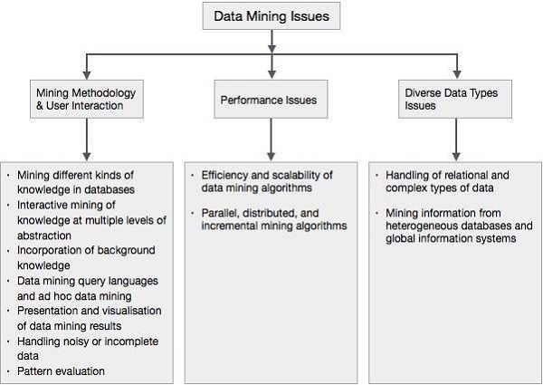
Data Mining Presentation
Data Mining Issues:-

Slide 15
Data Mining Presentation
Data Mining Issues:-
Mining different kinds of knowledge in databases −
Interactive mining of knowledge at multiple levels of abstraction −
Incorporation of background knowledge
Data mining query languages and ad hoc data mining
Presentation and visualization of data mining results
Handling noisy or incomplete data −
Pattern evaluation

Slide 16
Data Mining Presentation
Data Warehousing:- A data warehouse exhibits the following characteristics to support the management's decision-making process-
Subject Oriented
Integrated
Time variant
Non Volatile

Slide 17
Data Mining Presentation
Data Warehousing:- Data warehousing involves data cleaning, data integration, and data consolidations. To integrate heterogeneous databases, we have the following two approaches −
Query Driven Approach
Update Driven Approach

Slide 18
Data Mining Presentation
Data Warehousing:-
Query Driven Approach:- This is the traditional approach to integrate heterogeneous databases. This approach is used to build wrappers and integrators on top of multiple heterogeneous databases. These integrators are also known as mediators.
Process of Query Driven Approach:- When a query is issued to a client side, a metadata dictionary translates the query into the queries, appropriate for the individual heterogeneous site involved.
Now these queries are mapped and sent to the local query processor.
The results from heterogeneous sites are integrated into a global answer set.

Slide 19
Data Mining Presentation
Data Warehousing:-
Disadvantages:- This approach has the following disadvantages −
The Query Driven Approach needs complex integration and filtering processes.
It is very inefficient and very expensive for frequent queries.
This approach is expensive for queries that require aggregations.

Slide 20
Data Mining Presentation
Data Warehousing:-
Update Driven Approach:- Today's data warehouse systems follow update-driven approach rather than the traditional approach discussed earlier. In the update-driven approach, the information from multiple heterogeneous sources is integrated in advance and stored in a warehouse. This information is available for direct querying and analysis.

Slide 21
Data Mining Presentation
Data Warehousing:-
Advantages:- This approach has the following advantages −
This approach provides high performance.
The data can be copied, processed, integrated, annotated, summarized and restructured in the semantic data store in advance.
Query processing does not require interface with the processing at local sources.

Slide 22
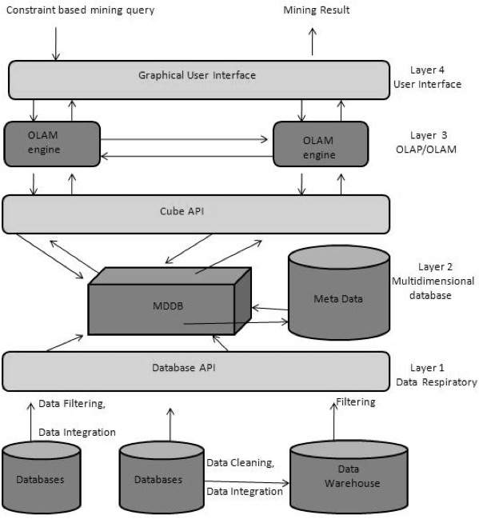
Data Mining Presentation
From Data Warehousing(OLAP) to Data Mining(OLAM):-

Slide 23
Data Mining Presentation
Importance of OLAM:- There are different importance point in OLAM. They are as follows:
High quality of data in data warehouse.
Available information processing infrastructure surrounding data warehouses
OLAP−based exploratory data analysis
Online selection of data mining functions

Slide 24
Data Mining Presentation
Data Mining:- Data mining is defined as extracting the information from a huge set of data. In other words we can say that data mining is mining the knowledge from data. This information can be used for any of the following applications −
Market Analysis
Fraud Detection
Customer Retention
Production Control
Science Exploration

Slide 25
Data Mining Presentation
Data Mining Engine:- Data mining engine is very essential to the data mining system. It consists of a set of functional modules that perform the following functions −
Characterization
Association and Correlation Analysis
Classification
Prediction
Cluster analysis
Outlier analysis
Evolution analysis

Slide 26
Data Mining Presentation
Data Mining Engine:- Data mining engine is very essential to the data mining system. It consists of a set of functional modules that perform the following functions −
Characterization
Association and Correlation Analysis
Classification
Prediction
Cluster analysis
Outlier analysis
Evolution analysis

Slide 27
Thank You

